Slide 1
Mini Project
Ayush Prasad
Ashish Kumar Singh

Slide 2
Abstract
The project is based on that for a given IPL Analysis, which IPL player is best for the ipl team so that we can bulid best ipl team out of every team in IPL.
The data set we have worked upon has been downloaded from Kaggle.com.
Firstly, we analyzed the data set by simply opening the “csv” file. Then we pre-processed the whole data set to remove the insignificant columns and empty rows. Also, to get to know the all unique values of each attributes.
Further, we performed the data visualization on the data set. We performed Univariate analysis of each to get an idea about how the values are entered in each attribute with reference to no. of entries.
The support of an objective which will use the predictive and anaysied capabilities of the players to target best playing 11 including batsman ,blower, wicketkeeper and allrounders to pick best 11 for the auction or building best team possible.

Slide 3

Libraries Used
Panda
Numpy

Slide 4
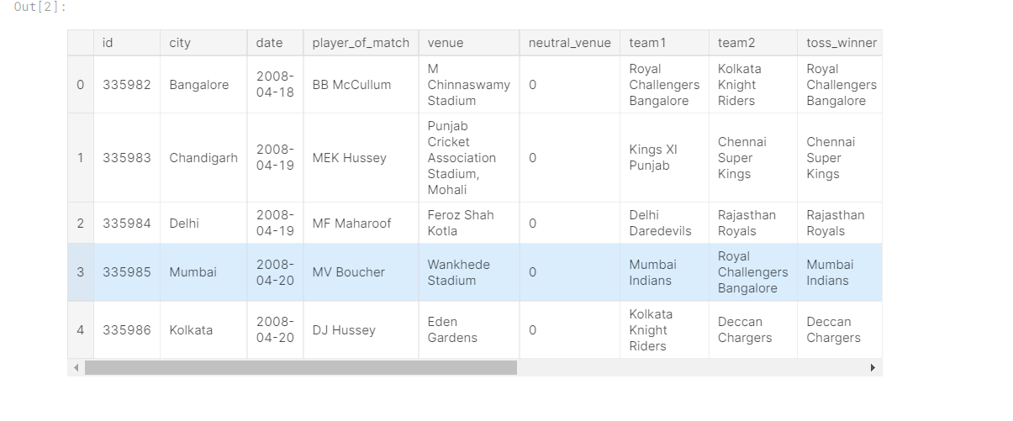
Description of Matches

Slide 5
Batting Points
Run -> +1
Boundary Bonus -> +1
Six Bonus -> +2
30 Run Bonus -> +4
Half-century Bonus -> +8
Century Bonus -> +16

Slide 6
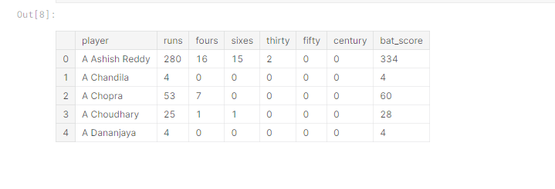
Batsmen Stat For Whole Tournament

Slide 7
Bowling Points
Wicket -> +25
Bonus (LBW / Bowled) -> +8
3 Wicket Bonus -> +4
4 Wicket Bonus -> +8
5 Wicket Bonus -> +16

Slide 8
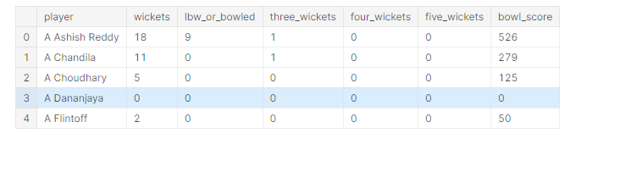
Bowler Stats For Whole Tournament

Slide 9
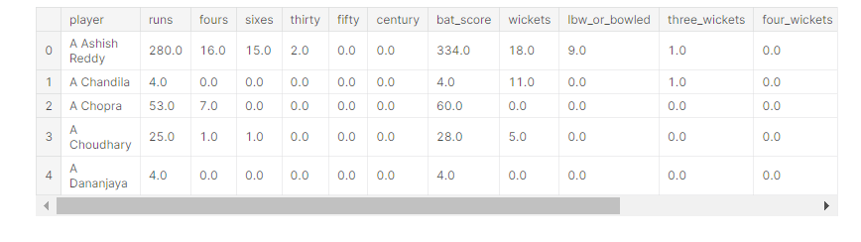
All-rounder Stats For Whole Tournament

Slide 10
Description of Dream 11 Team
Batsman (BAT) - 4
Wicket Keeper (WK) - 1
All Rounder (AR) - 3
Bowler (BWL) - 3

Slide 11
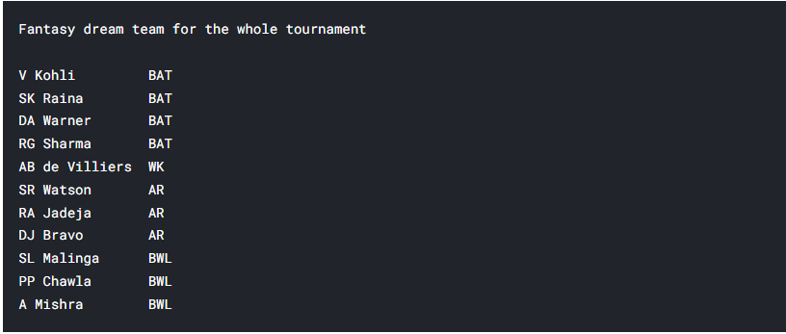
Fantasy Dream Team For Whole Tournament

Slide 12
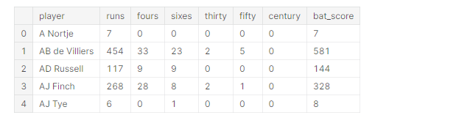
Batsmen Stat for Season 2020

Slide 13
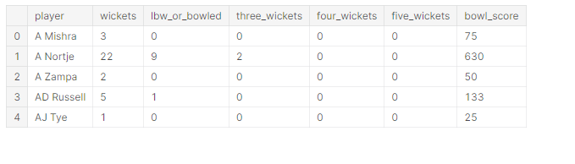
Bowler Stat For Season 2020

Slide 14
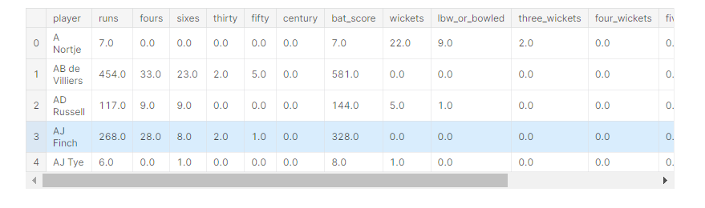
All-rounder Stat For Season 2020

Slide 15
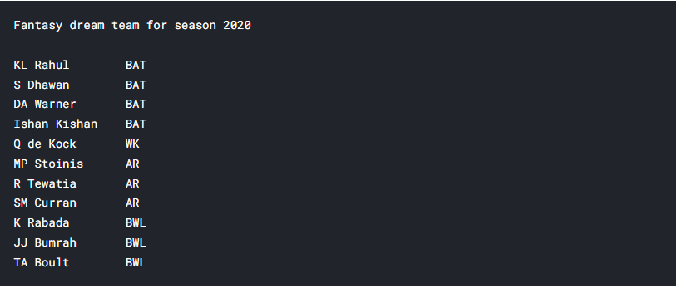
Fantasy Dream Team For Season 2020

Slide 16
Refrences
Downloading data set:
REFERENCES
https://archive.ics.uci.edu/ml/machine-learning-databases/adult/ http://abhigyan.dataritz.com/mod/folder/view.php?id=602 Loading and analyzing
https://pandas.pydata.org/
https://numpy.org/
Pre-processing
https://towardsdatascience.com/data-preprocessing-in-python-b52b652e37d5 https://www.geeksforgeeks.org/data-preprocessing-machine-learning-python/ https://scikit-learn.org/stable/modules/preprocessing.html
https://www.tutorialspoint.com/machine_learning_with_python/machine_learning_with_python_dat a_preprocessing_analysis_visualization.htm
https://www.datacamp.com/courses/preprocessing-for-machine-learning-in-python
Data Visualization https://matplotlib.org/tutorials/index.html https://python-graph-gallery.com/seaborn/ Machine Learning Algorithm
https://www.datacamp.com/community/tutorials/understanding-logistic-regression-python
https://www.datacamp.com/community/tutorials/random-forests-classifier-python https://www.datacamp.com/community/tutorials/decision-tree-classification-python https://www.datacamp.com/community/tutorials/k-nearest-neighbor-classification-scikit-learn
GUI- Tkinter
https://realpython.com/python-gui-tkinter/

Slide 17
Thank You!

